Slide 1
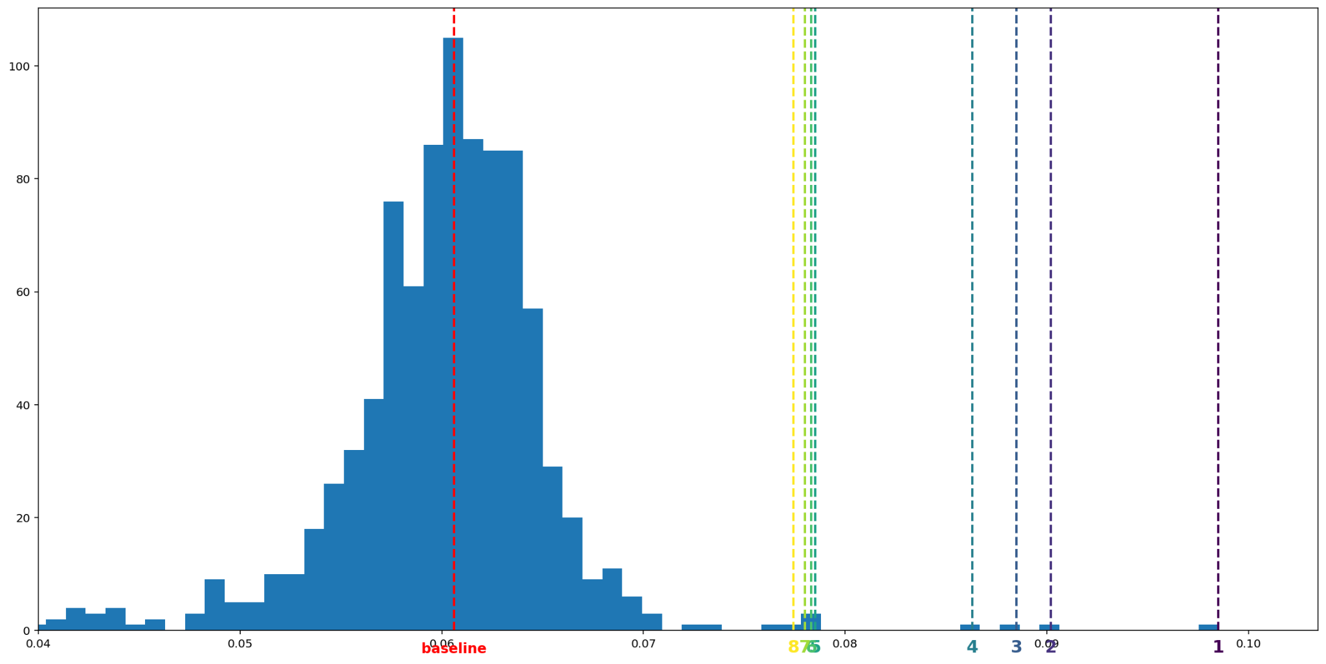
Highlights of the NeurIPS 2023 unlearning challenge
5,161 registrations
1,338 participants from 72 countries.
For 500 (including 44 in the top 100!), this was their first competition
1,121 teams
1,923 submissions
🤯
Leaderboard: 40% scored above baseline
Notes:
This competition ended with 5,161 registrations and 1,338 participants on 1,121 teams. We had 1,923 submissions from 72 countries. For 500 users (including 44 in the top 100!), this was their first competition. Thank you all for your hard work in this competition and congratulations to our winners and to those who gained a new ranking!
https://g.co/bard/share/e45e8d81649a

Slide 2
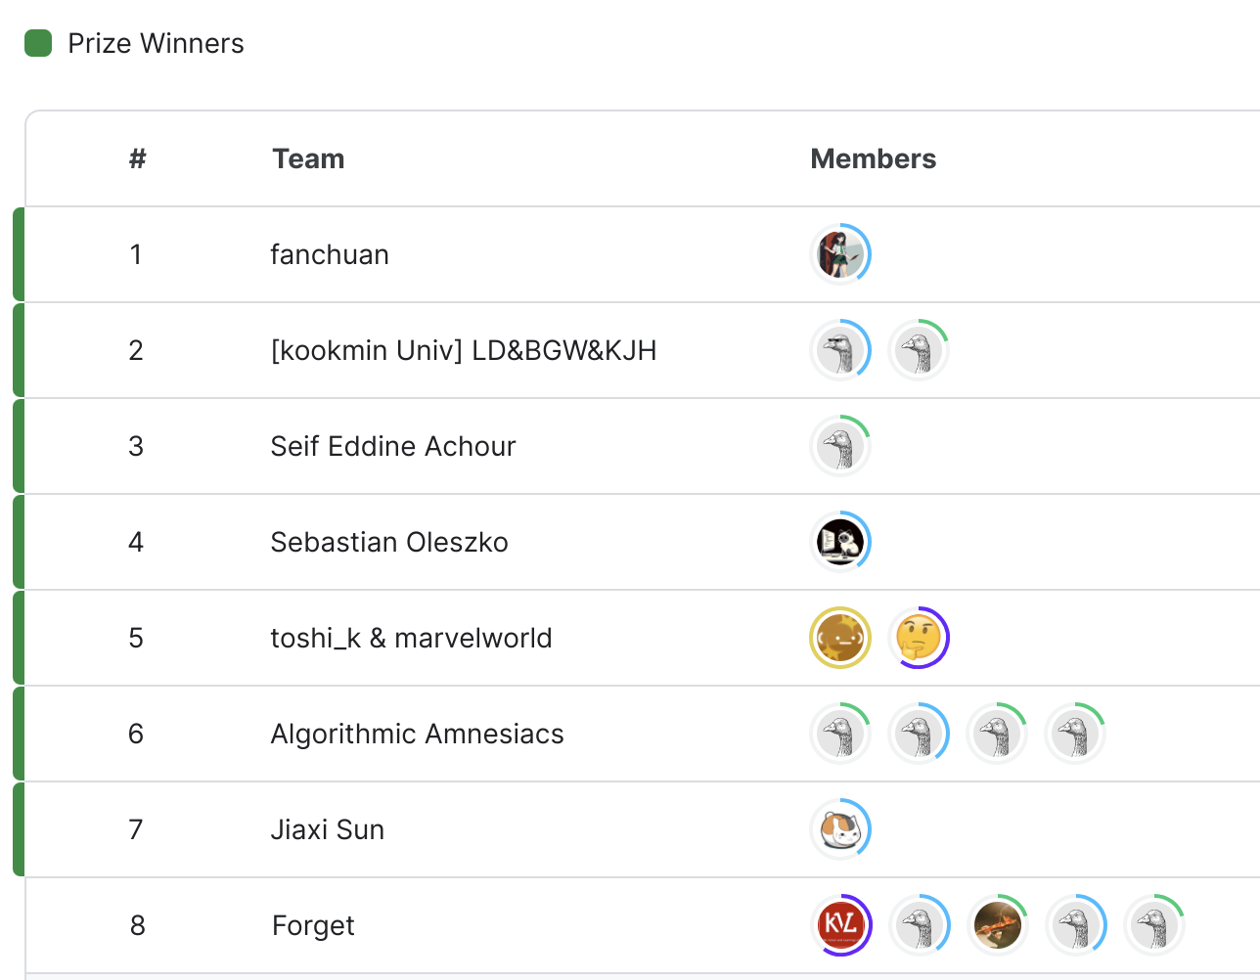
Top submissions

Slide 3
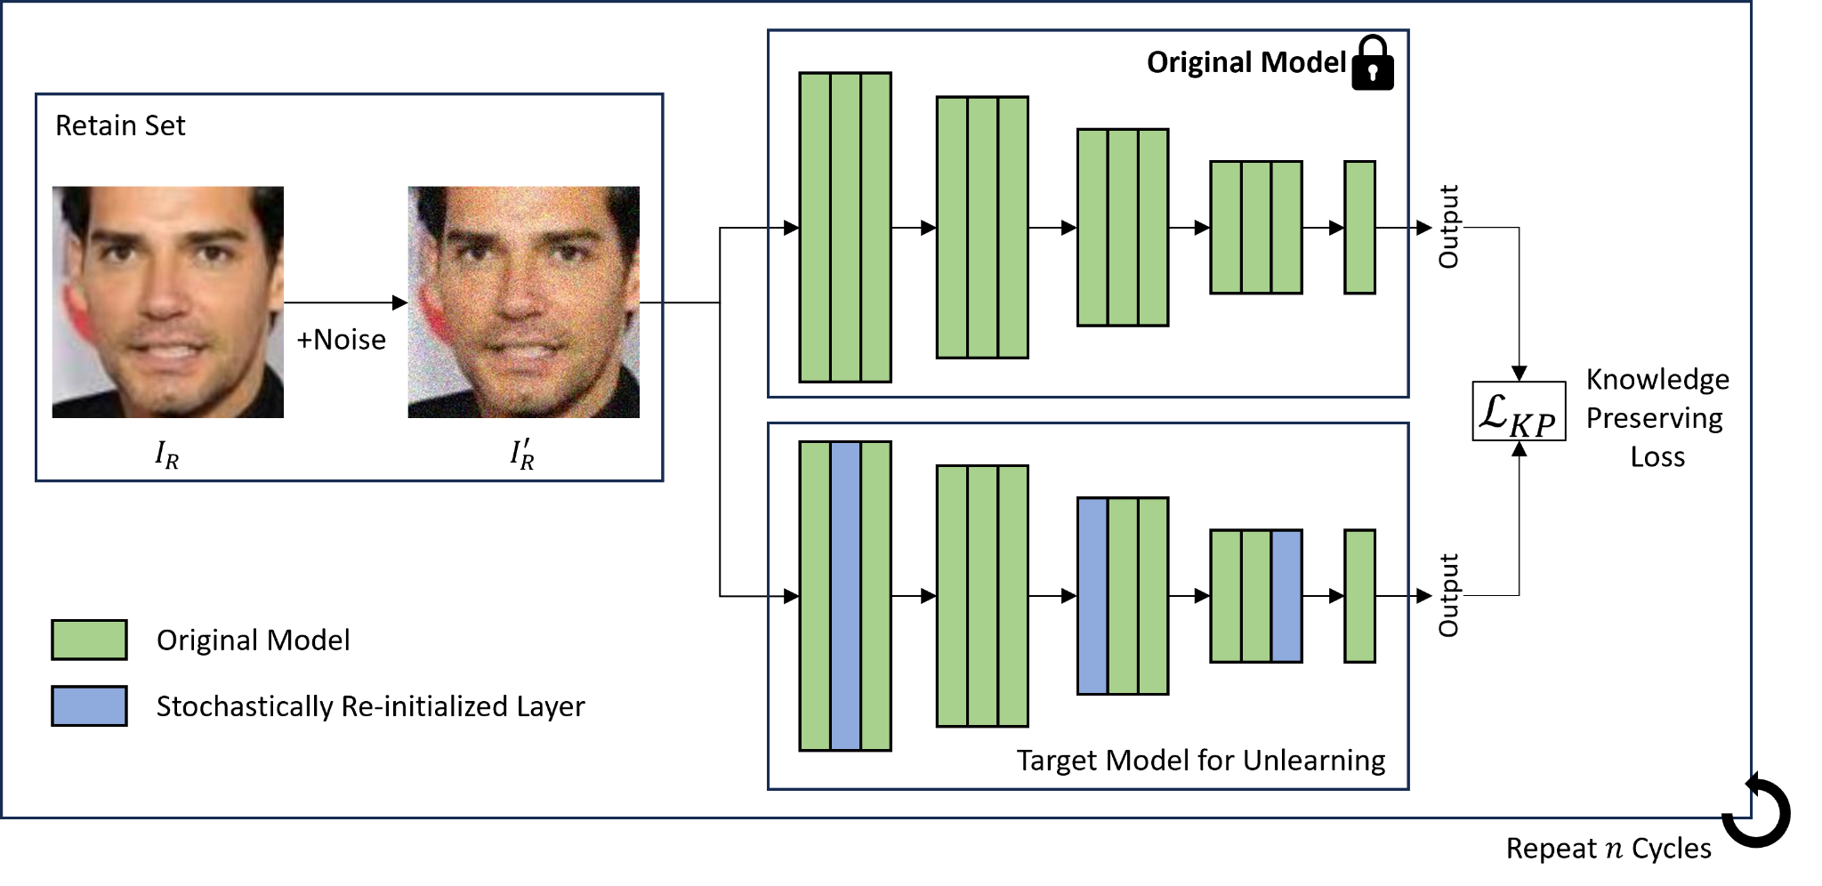
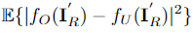
8th place solution - Team Forget
(1) Forgetting phase: model parameters are stochastically selected and re-initialized.
- FC, Projection-shortcut layers are excluded from the selection pool.
(2) Remembering phase: knowledge preserving loss is calculated between the original model and the target unlearning model.
- Knowledge Preserving Loss:
- Gaussian noise is added to the image as data augmentation.
- It reminds the target model about the retain set.
(3) Forgetting phase and Remembering phase are repeated for n cycles to enhance unlearning performance.
Notes:
https://g.co/bard/share/e45e8d81649a

Slide 4
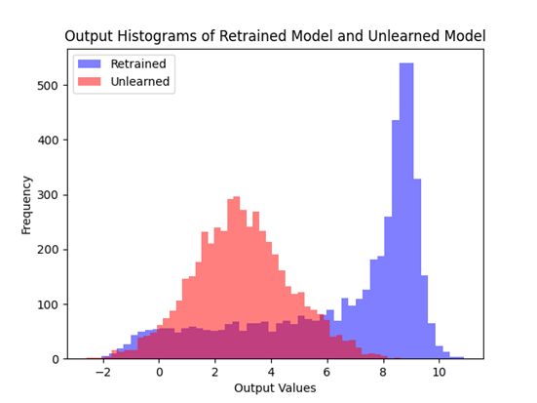
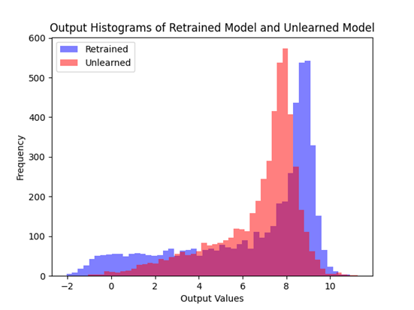
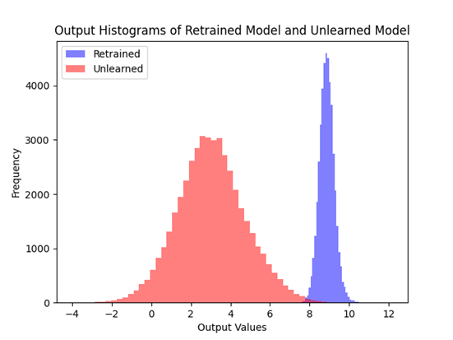
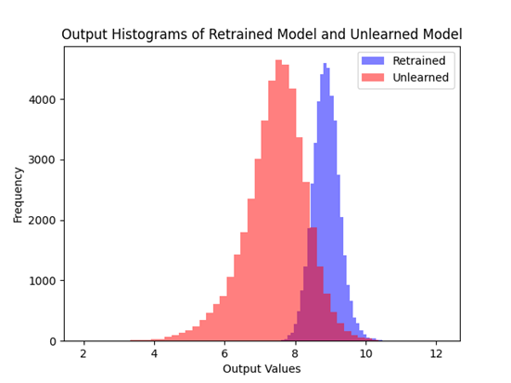
8th place solution - Team Forget
- Histograms of logits from retrained model and unlearned models are visualized.
- This observation is acquired from local experiments on CIFAR-10.
- MSE loss makes closer distributions than CE loss for both forget set and retain set.
Forget Set
Retain Set
(a) CE
(b) MSE
Figure. Comparison of logit distributions between CE loss and MSE loss
Notes:
https://g.co/bard/share/e45e8d81649a

Slide 5
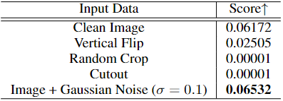
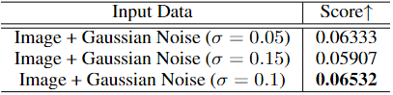
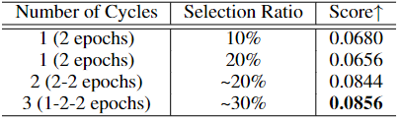
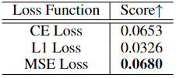
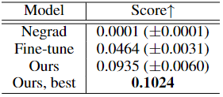
8th place solution - Team Forget
- Gaussian Noise (σ=0.1) is the best data augmentation compared with other data augmentation techniques.
- Compared with CE loss and L1 loss, MSE loss demonstrates the best score.
- Additionally, increasing the cycles highly improves the performance.
- From these observations, we build the final submission.
Table 1. Comparison between different data augmentation techniques
Table 2. Comparison between different sigma of gaussian noise
Table 4. Effect of cycles
Table 3. Comparison between different loss functions
Table 5. Final submission score compared with other unlearning methods
Notes:
https://g.co/bard/share/e45e8d81649a

Slide 6
7th place solution - Jiaxi Sun
Solution that only makes use of retain set
Reset parameters of last layer
Randomly selecting N=9 layers from the network and add noise
Adding noise helps the network 'forget' the information it has learned, and the randomness of the layer selection contributes to enhancing the model's diversity.
Fine-tune all network layers
Notes:
https://g.co/bard/share/e45e8d81649a

Slide 7
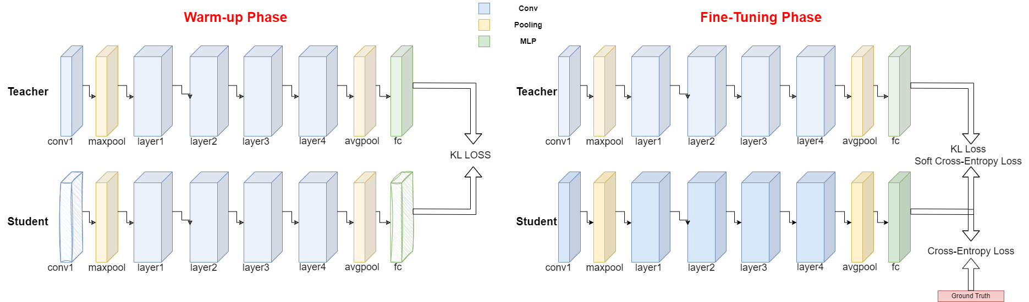
6th place solution - Algorithmic Amnesiacs
Reset first and last layer of the original model.
Warm-up phase employing knowledge distillation
Fine-tuning phase.
Notes:
https://g.co/bard/share/e45e8d81649a

Slide 8
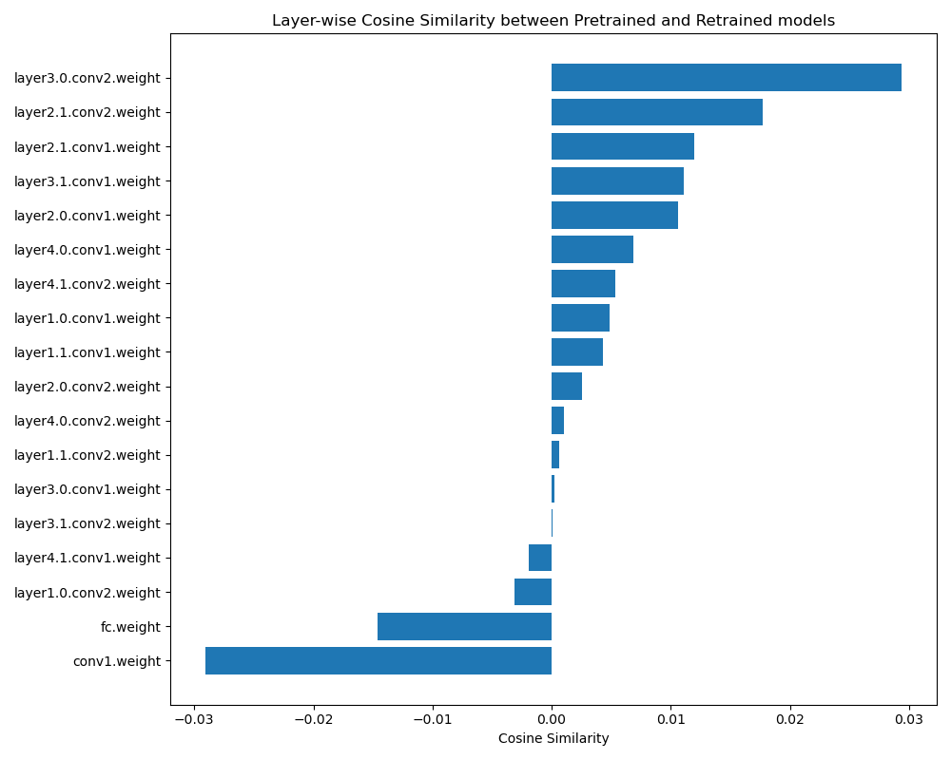
6th place solution - Algorithmic Amnesiacs
Reset first and last layers:
First layer significantly influences the rest of the model layers and the last layer determines the model’s final output distribution.
On CIFAR-10: these two layers exhibited the most negative cosine similarity between model weights trained on the full training set and models trained from scratch on a smaller subset (i.e., the retain set).
Notes:
https://g.co/bard/share/e45e8d81649a

Slide 9
6th place solution - Algorithmic Amnesiacs
Warm-up phase
Minimize KL divergence between the outputs of the original pre-trained model (teacher) and the reinitialized model (student) on the validation set.
Notes:
https://g.co/bard/share/e45e8d81649a

Slide 10
6th place solution - Algorithmic Amnesiacs
Fine-tuning using 3 losses
Cross-entropy for model's accuracy using hard labels on retain set.
Soft cross-entropy for predictions of the student model with soft labels from the teacher model.
KL divergence combined with the soft cross-entropy facilitates rapid knowledge transfer and broader information capture.
Notes:
https://g.co/bard/share/e45e8d81649a

Slide 11
5th place solution - toshi_k & marvelworld
Summary
Our solution is the ensemble of two approaches: (1) Retraining from transposed weights (2) Fine-tuning with pseudo-labels.
Our solution is built upon two distinctive approaches, contributing to the stability of our solution in the private LB.
(1) Retraining from transposed weights | (2) Fine-tune with pseudo-labels | Public LB | Private LB
512 models | 0 models | 0.0720386947 | -
0 models | 512 models | 0.0707241647 | -
246 models | 266 models | - | 0.0785184178
266 models | 246 models | - | 0.0756313425
Notes:
https://g.co/bard/share/e45e8d81649a

Slide 12
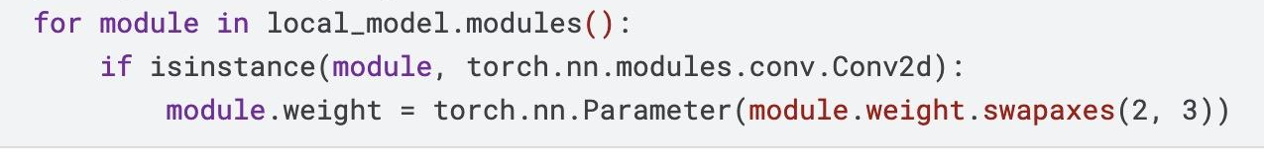
5th place solution - toshi_k & marvelworld
(1) Retraining from transposed weights
This part retrains the model using a modified version of the original model.
In this modification, all weights in Conv2D are transposed. This process helps in forgetting samples in the forget-set, enabling the reuse of valuable features from the original model.
Transpose !
ResNet18
w1 | w2 | w3
w4 | w5 | w6
w7 | w8 | w9
w9 | w7 | w3
w8 | w5 | w2
w7 | w4 | w1
Block A
7x7 Conv 64
3x3 Conv 64
All weights in Conv2D are transposed
Block B
3x3 Conv 64
The modification is carried out simply like this.
Notes:
https://g.co/bard/share/e45e8d81649a

Slide 13
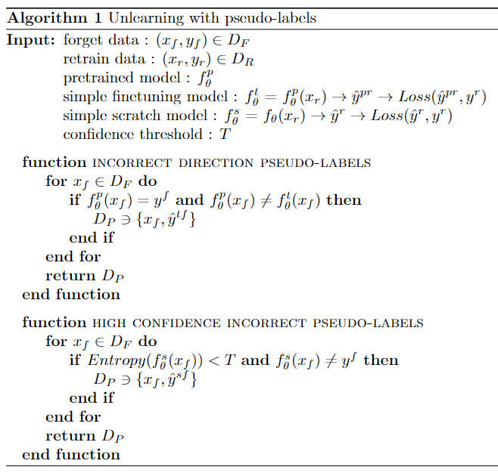
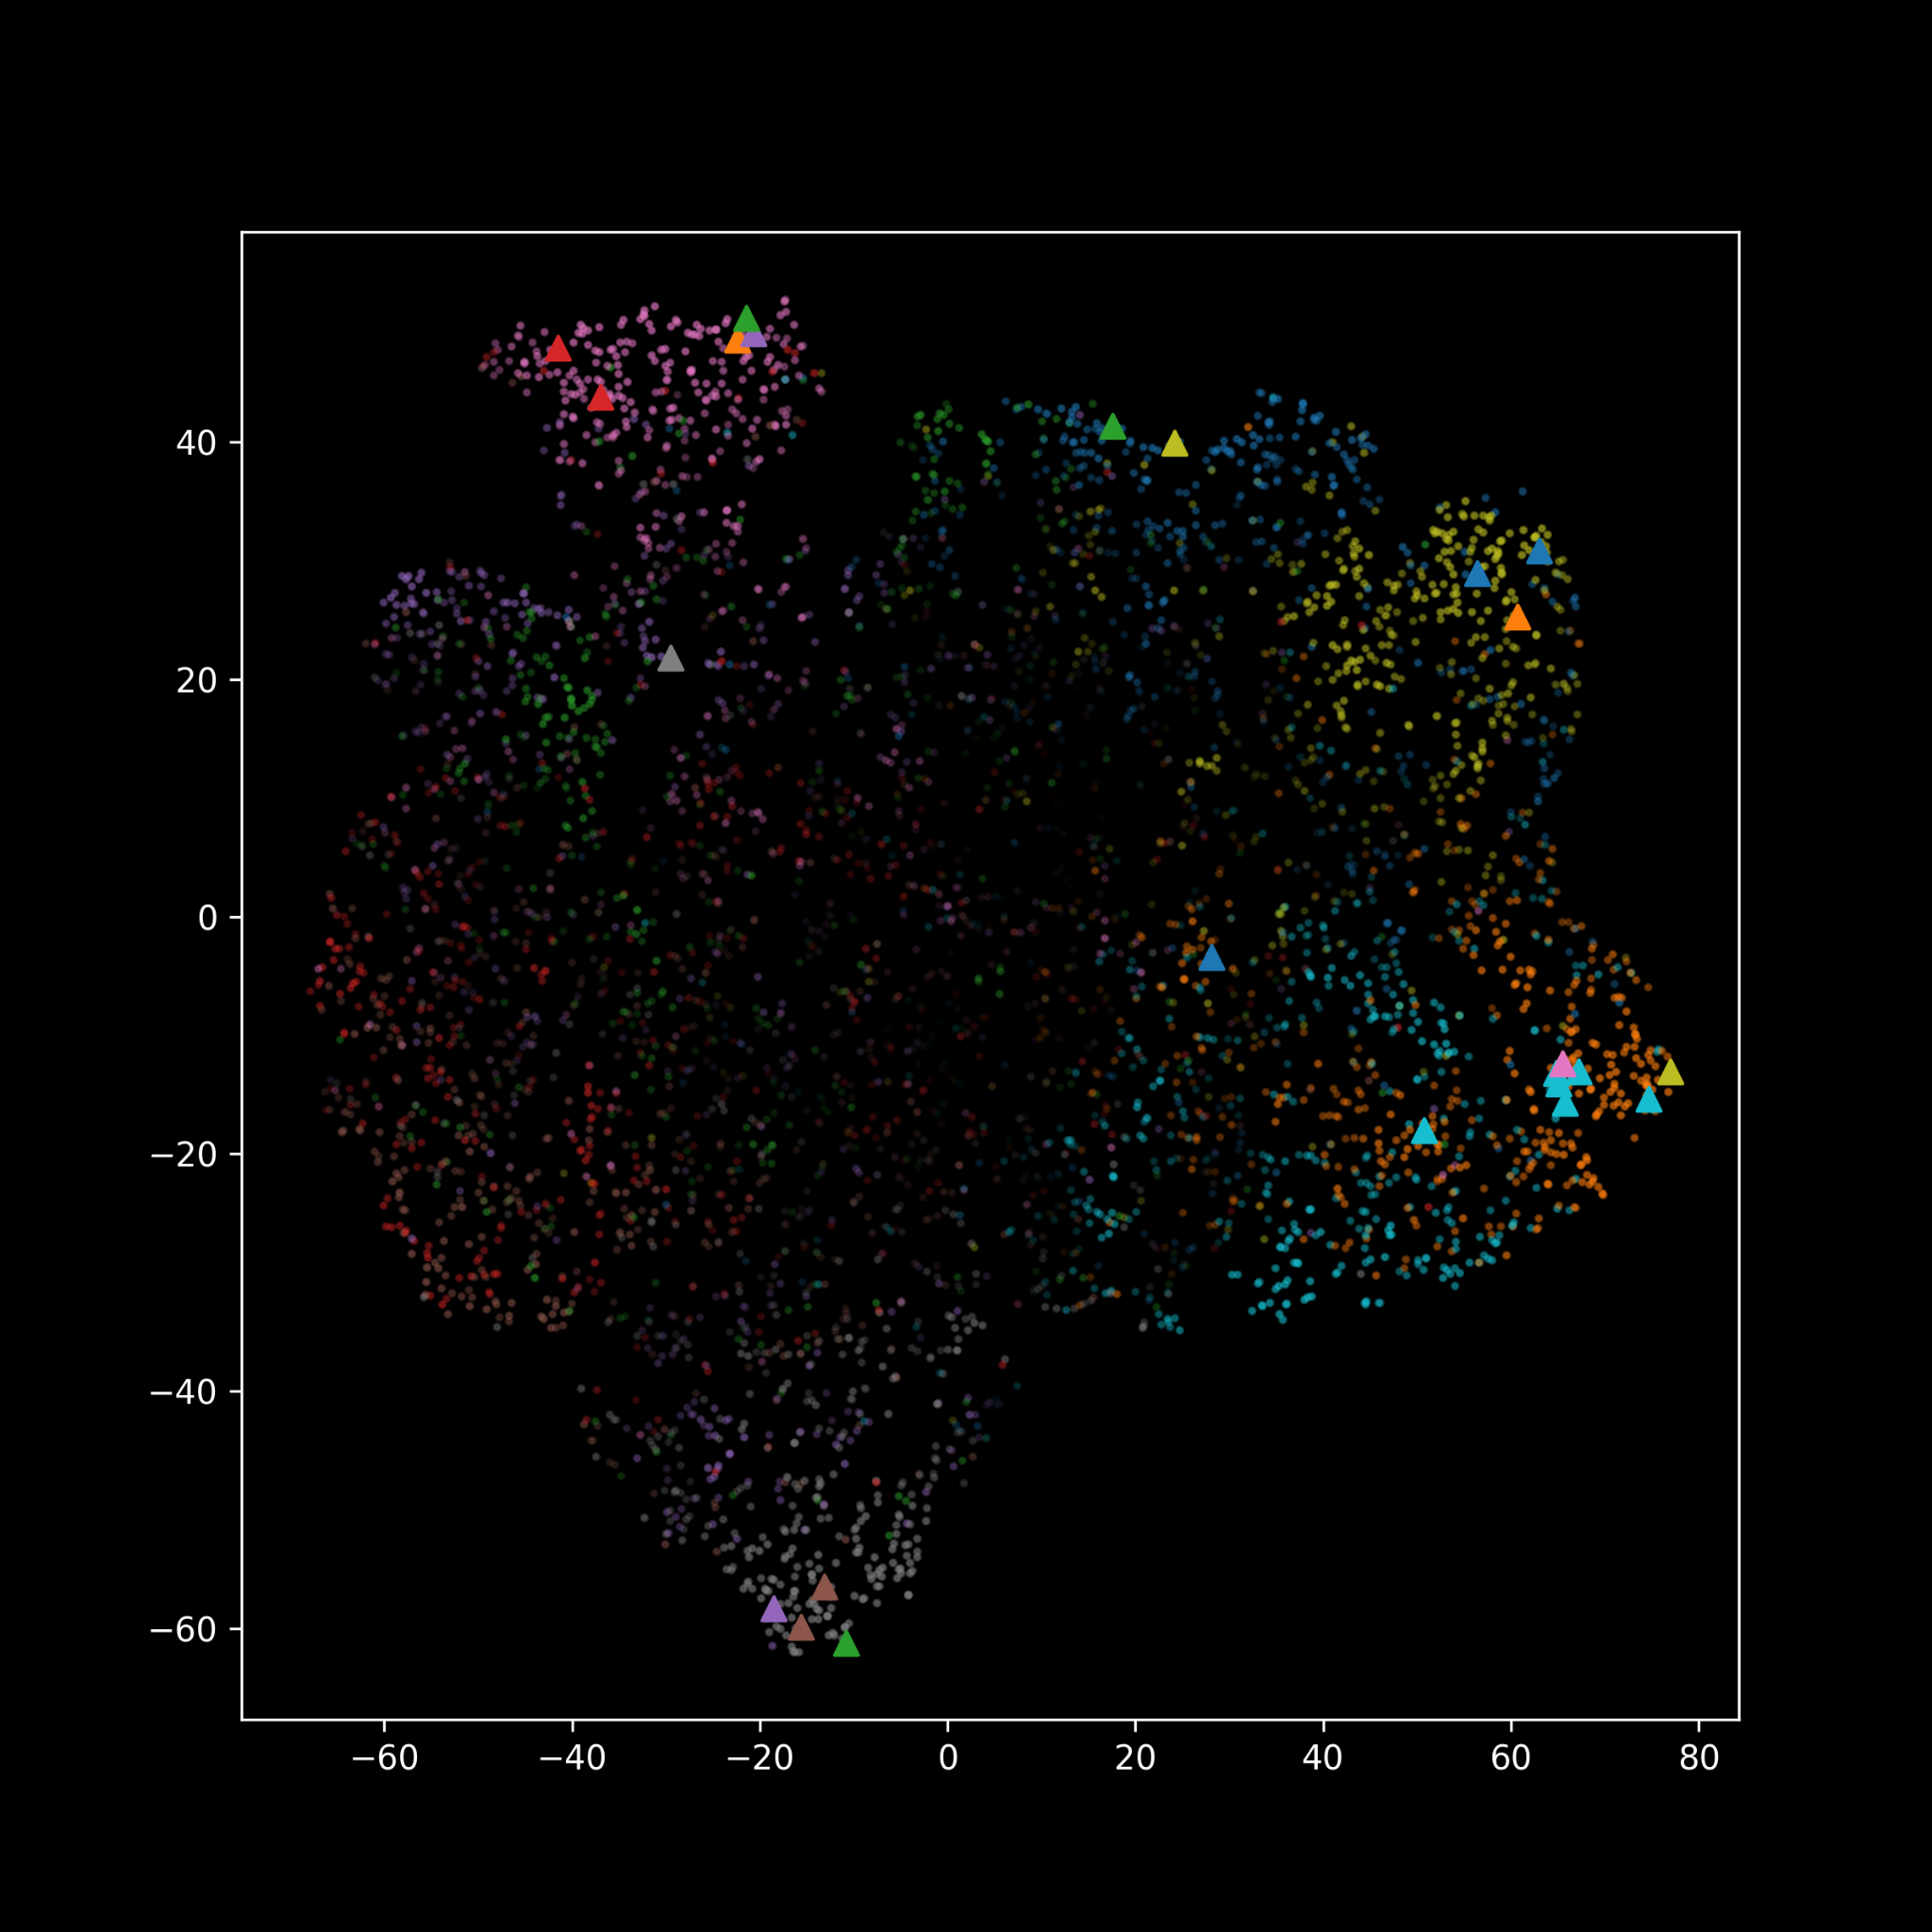
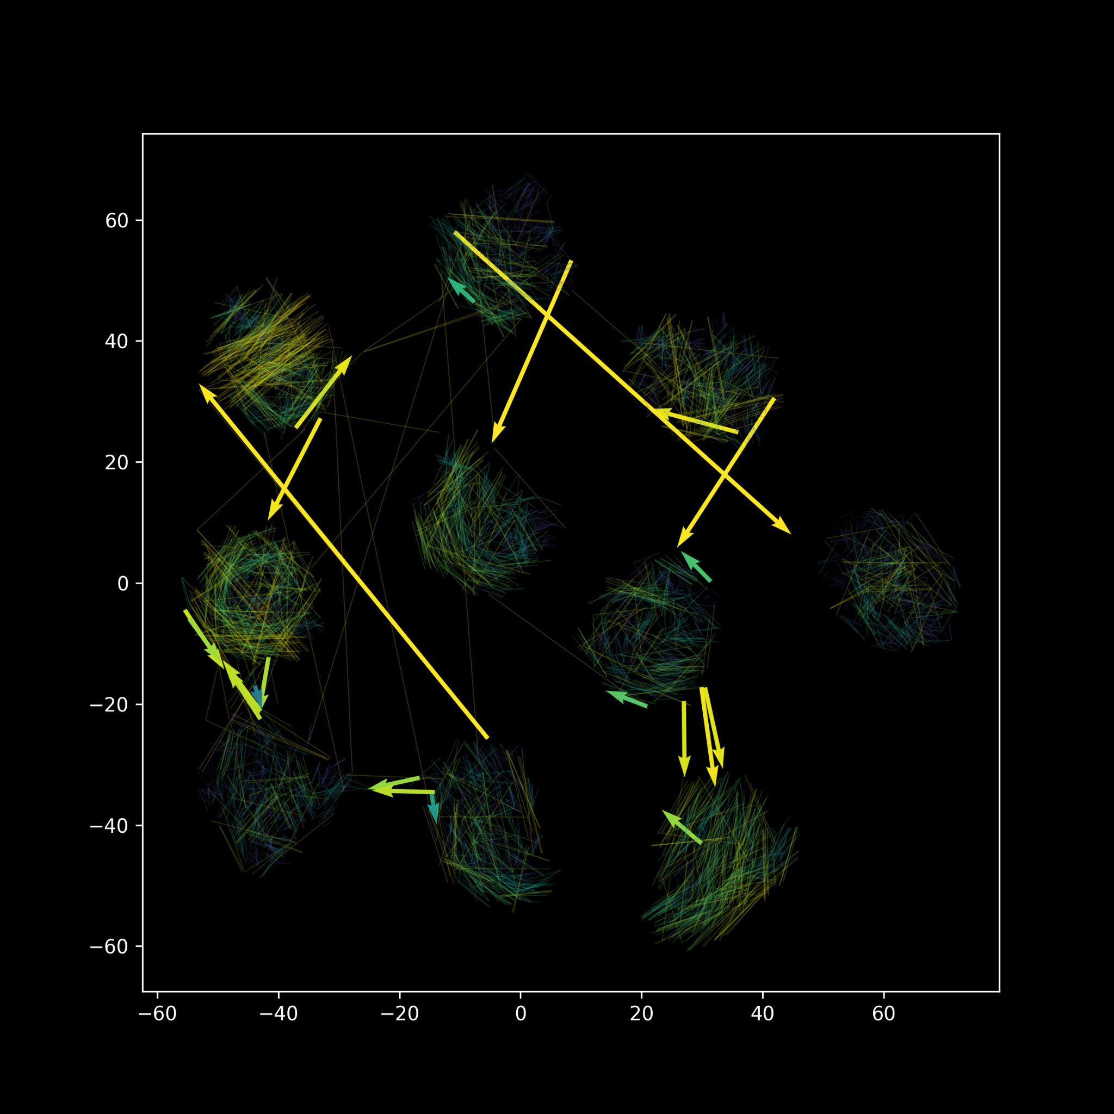
5th place solution - toshi_k & marvelworld
(2) Fine-tuning with pseudo-labels
This part reproduces behavior (errors) on the forget data with pseudo-labels from two functions.
Figure 1: Inference shifts between the pretrained model and the fine-tuned model, showcasing significant shifts in the incorrect direction.
Figure 2: Inference results of the scratch model. Triangle-up marker indicates high confidence but they are making incorrect inferences.
Notes:
https://g.co/bard/share/e45e8d81649a

Slide 14
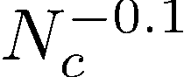
4th place solution - Sebastian Oleszko
Re-initializing/pruning 99% of parameters based on L1-norm (Unstructured)
Weights: Pytorch default initialization
Biases: Set to zero (prune)
Fine-tune on retain dataset
Regularize using entropy
Cross entropy class weights as
Initial weights
Cross-entropy
MSE of entropy
Notes:
https://g.co/bard/share/e45e8d81649a

Slide 15
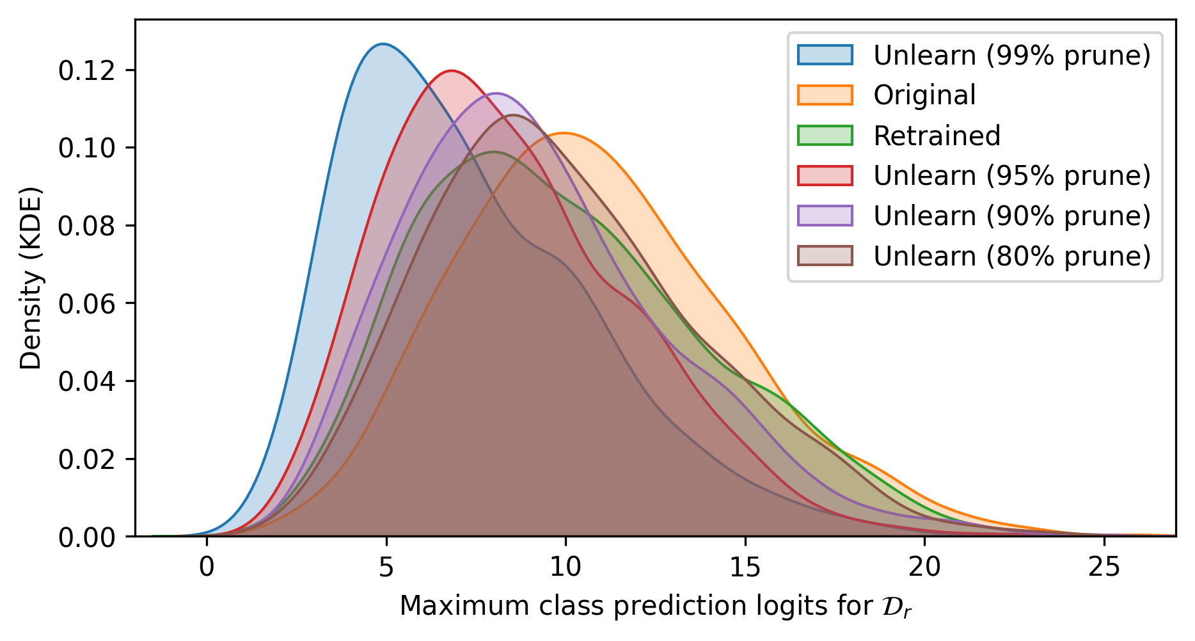
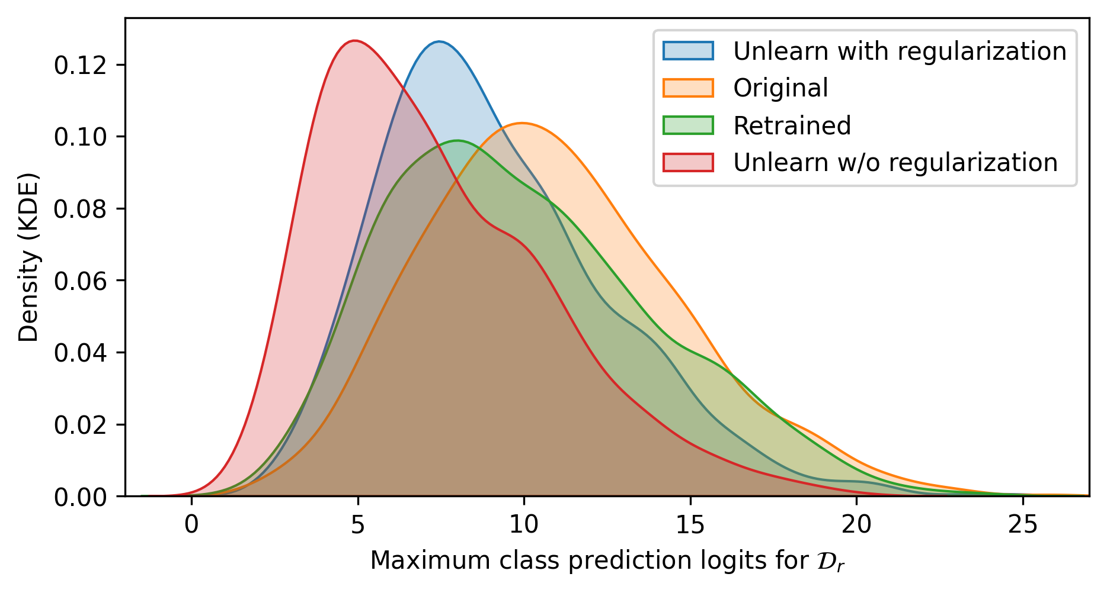
4th place solution - Sebastian Oleszko
CIFAR-10 experiment
Impact of most important hyperparameters: Learning rate/epochs and pruning percentage
Effect of including entropy regularization
Tuning on public submission scores
Increase Pruning %
Notes:
https://g.co/bard/share/e45e8d81649a

Slide 16
4th place solution - Sebastian Oleszko
Entropy-based regularization Helps to achieve a more similar prediction distribution/confidence.
Unlearning through pruning/re-initialization Effective as unlearning technique. Most of the performance is retainable even with high pruning percentage.
Concluding thoughts
Hyperparameter tuning is very important to achieve high scores
Final submission was only fine-tuned for 3.2 epochs - maybe not optimal
Notes:
https://g.co/bard/share/e45e8d81649a

Slide 17
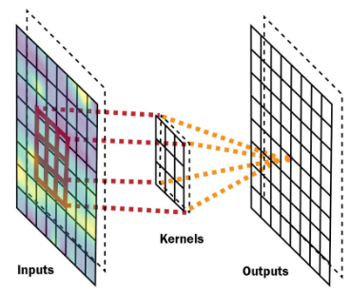
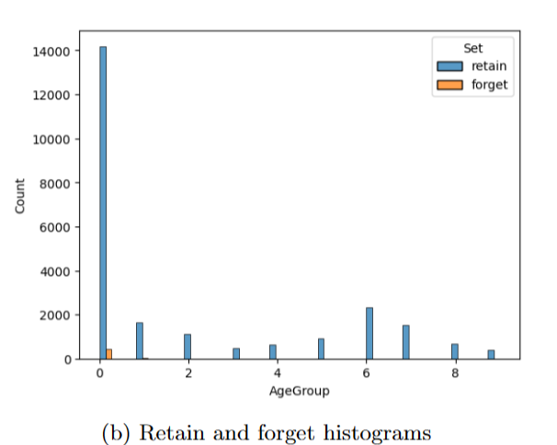
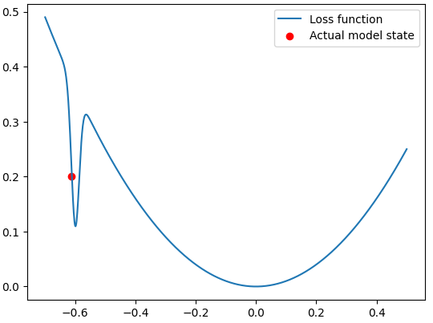
3rd place solution - Seif Eddine Achour
Competition approach: vision confusion - reconstitution
Vision Confusion
Class Imbalance
Details forgotten but the general idea was retained
Weighted cross entropy
Hard Differentiability
Model Unlearned!
Slight confusion & a final stabilisating epoch
Vision reconstitution on the Retain Set through 3 epochs
The confusion process is instant. The whole computation is dedicated to the vision reconstitution (Time Efficient).
Notes:
https://g.co/bard/share/e45e8d81649a

Slide 18
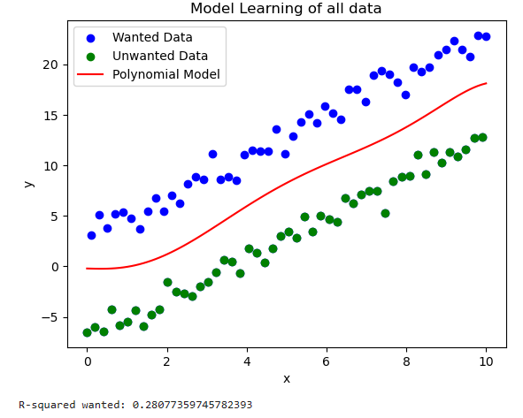
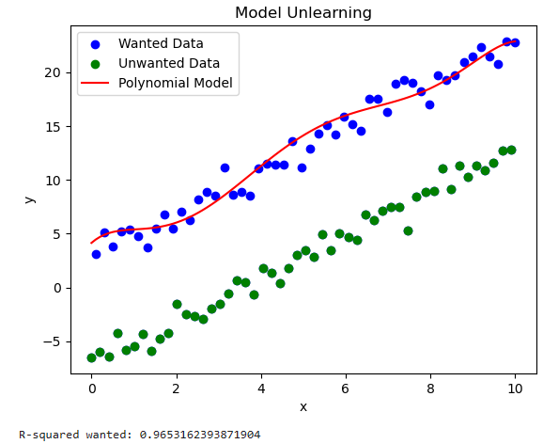
3rd place solution - Seif Eddine Achour
Paper approach: Loss landscape adjuster
Regression
The model forgot totally about the unwanted data despite its big size
Original r-squared = 0.28 vs Unlearned r-squared = 0.97!
Notes:
https://g.co/bard/share/e45e8d81649a

Slide 19
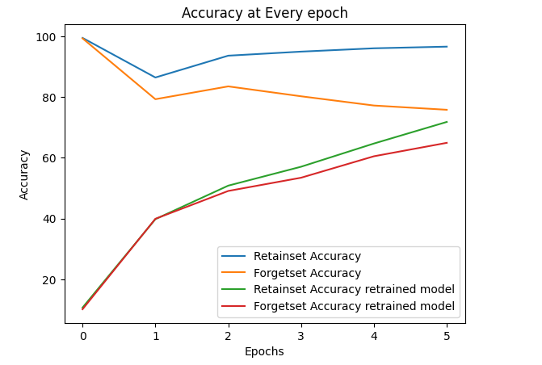
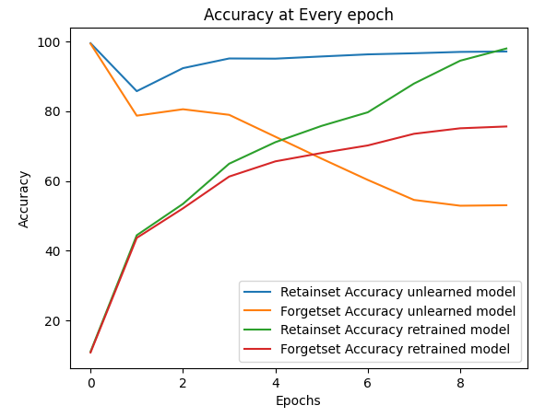
3rd place solution - Seif Eddine Achour
Paper approach: Loss landscape adjuster
Classification
Good results without considering the Forget Set (1st approach)
The proper use of the Forget Set will certainly improve results
The retrained model is not always the ideal one
-1% accuracy on Retain Set lead to -24% of accuracy on Forget Set
The metric which check the similitude between the unlearned and retrained model is not that representative for the unlearning performance
Notes:
https://g.co/bard/share/e45e8d81649a

Slide 20
2nd place solution - [kookmin Univ] LD&BGW&KJH
Gradient-based re-initialization method
We assumed that if the gradients of the weights in the model, specifically in the retain set and forget set, are similar, it becomes challenging to forget information from the forget set during the retraining of the retain set.
proposed gradient-based re-initialization method for unlearning consists of three main steps:
1. Gradient Collection:
Gradient information is collected from the forget set and the retain set.
2. Weight initialization:
Based on the gradient information collected in the first step, a percentage of the convolution filter weights are re-initialized.
3. Retraining:
The model is retrained with the retain set. The learning rate for the Uninitialized weights uses 1/10 of the base learning rates.
Notes:
https://g.co/bard/share/e45e8d81649a

Slide 21
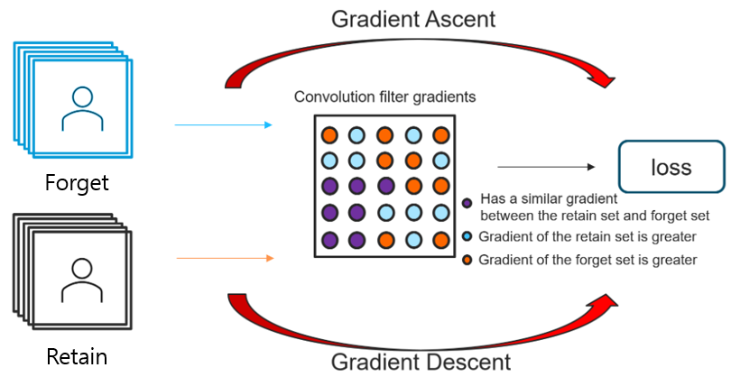
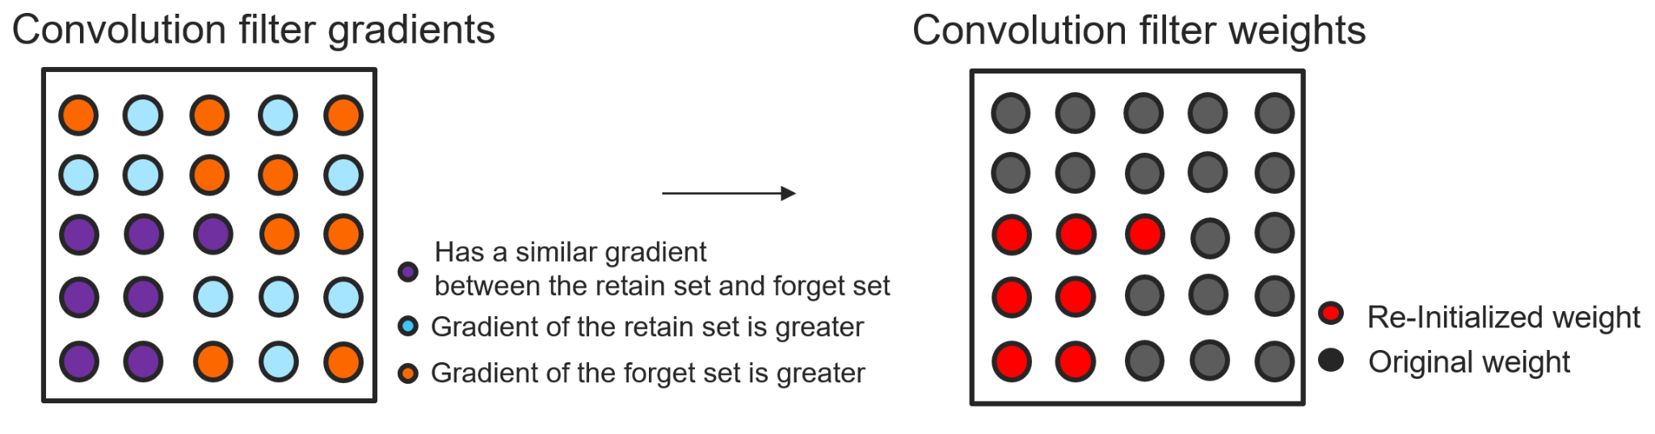
2nd place solution - [kookmin Univ] LD&BGW&KJH
1. Gradient Collection
Collect gradients of forget set using gradient ascent
Collect gradients of retain set using gradient descent
Random sampling was used from the retain set to match the number of samples in the forget set
In short, this is simply subtracting forget set’s gradient from the retain set’s gradient
2. Weight initialization
Based on the gradient information a percentage of the convolution filter weights are re-initialized
Our best method re-initialized 30% of convolution filter weights
Notes:
https://g.co/bard/share/e45e8d81649a

Slide 22
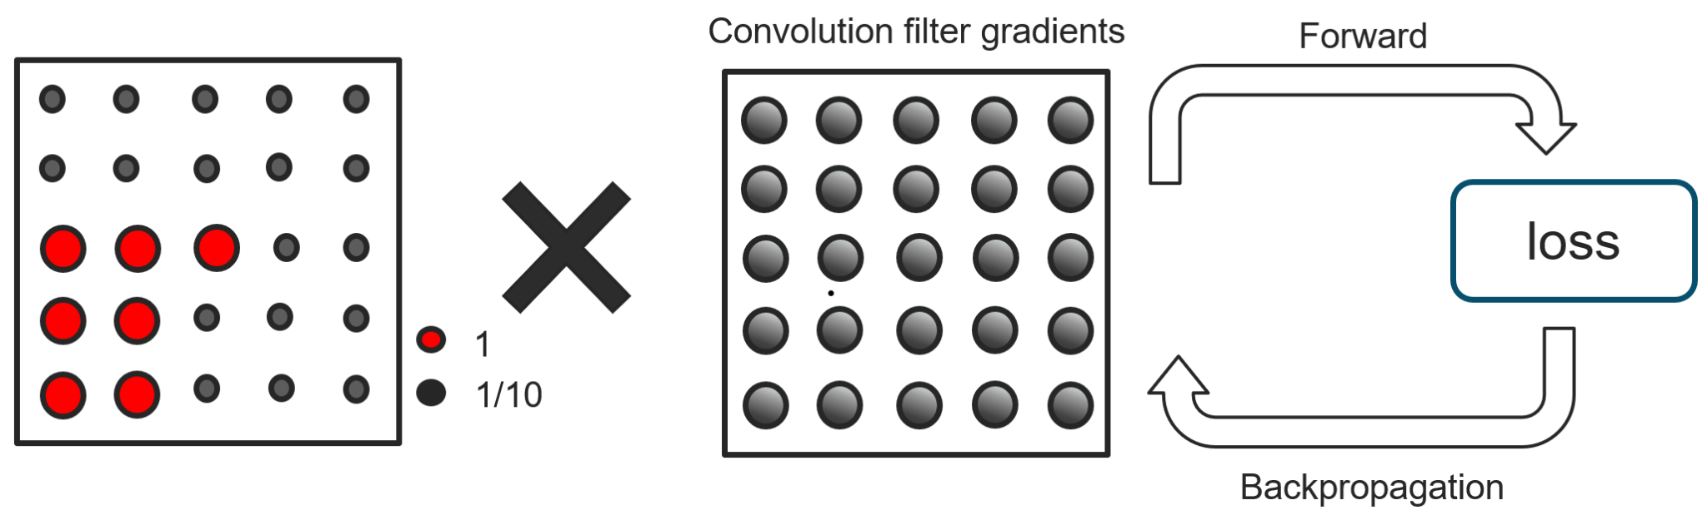
2nd place solution - [kookmin Univ] LD&BGW&KJH
3. Retraining
Re-initialized Model is trained using the retain set
Learning rate for the uninitialized weights uses 1/10 of the base learning rates (accomplished by scaling the gradient of uninitialized weight)
Used a linear decay learning rate scheduler with a few warmup epoch
Consistently produces better results than other learning rate schedulers
Used warmup epoch of 3 (0.00033 to 0.001 in the first 3 epochs, and then linearly decreases from 0.001 to 0.00033 in the last 2 epochs)
Notes:
https://g.co/bard/share/e45e8d81649a

Slide 23
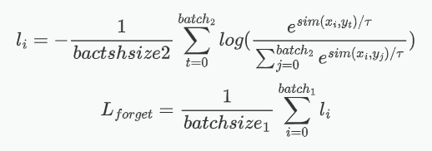
1st place solution - fanchuan
Forget phase: minimize KL-divergence between output logits and a uniform pseudo label on forget set.
Adversarial fine-tuning phase. Alternate between "forget" and "retain" rounds:
Forget round: Maximize dissimilarity
between logits of forget and retain set
Retain: original loss (cross entropy) on retain set.
Trick: Increase batch size from 64 to 256 to be able to perform more epochs (6 -> 8)
Notes:
https://g.co/bard/share/e45e8d81649a

